Slide 1
Spinning HDD Platter
By Tristan Morse

Slide 2
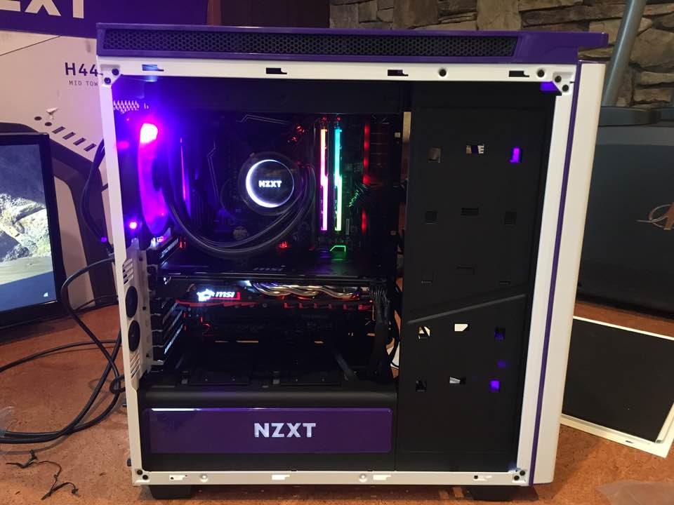
The Observation and Concepts
Interest
Computer Science major and new media minor
Built a computer (last weekend)
Observation
HDD is a “Hard Disk Drive” which is used for computer storage
Uses magnetic signals to encode data on “platters”
Platters rotate at certain RPM
Average angular acceleration of a Seagate Barracuda 2TB HDD
Physics Concepts
Rotational Kinematics

Slide 3
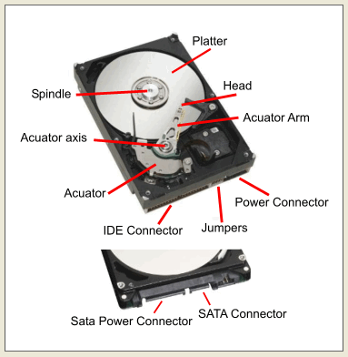
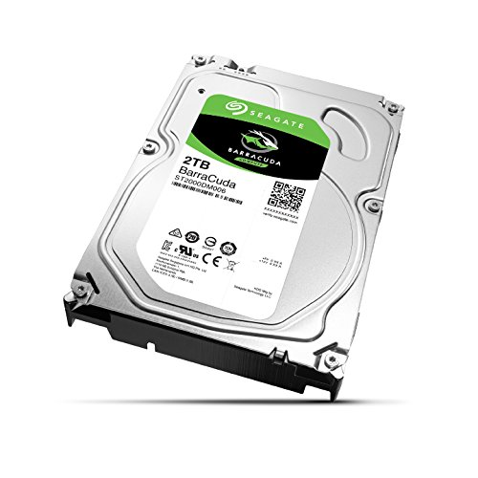

Slide 4
Question and Data/Assumptions
Question:
What is the average angular acceleration of a 7200RPM HDD platter within a 3 second time interval?
Data
Rotation rate of a platter: 7200RPM
Time interval: 3 Seconds
Assumptions
Starts at rest
Nothing to catch on

Slide 5
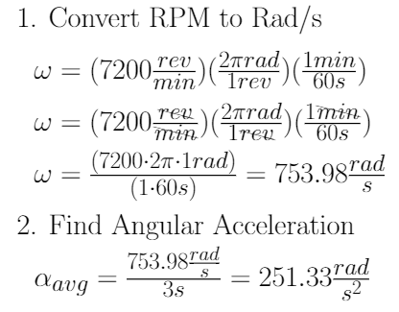

Calculations and Reflections
Reflection
No HDD to experiment with
More accurate measurements (tachometer)

